Slide 1
Machine Learning 1
Introduction
Sudeshna Sarkar
IIT Kharagpur

Slide 2
What is Machine Learning?
Adapt to / learn from data
  To optimize a performance function
Can be used to:
  Extract knowledge from data
  Learn tasks that are difficult to formalise
  Create software that improves over time

Slide 3
When to learn
Human expertise does not exist
  (navigating on Mars)
Humans are unable to explain their expertise
  (speech recognition)
Solution changes in time
  (routing on a computer network)
Solution needs to be adapted to particular cases
  (user biometrics)
Learning involves
Learning general models from data
Data is cheap and abundant. Knowledge is expensive and scarce.
Build a model that is a good and useful approximation to the data

Slide 4
Applications
Speech and hand-writing recognition
Autonomous robot control
Data mining and bioinformatics: motifs, alignment, …
Playing games
Fault detection
Clinical diagnosis
Spam email detection
Credit scoring, fraud detection
Applications are diverse but methods are generic

Slide 5
Learning applied to NLP problems
Decisional problems involving ambiguity resolution
  Word selection
  Semantic ambiguity (polysemy)
  PP attachment
  Reference ambiguity (anaphora)
  Text categorization
  Document filtering
  Word sense disambiguation

Slide 6
Learning applied to NLP problems
Problems involving sequence tagging and detection of sequential structures
  POS tagging
  Named entity recognition
  Syntactic chunking
Problems with output as hierarchical structure
  Clause detection
  Full parsing
  IE of complex concepts

Slide 7
Example-based learning:
Concept learning
The computer attempts to learn a concept, i.e., a general description (e.g., arch-learning)
  Input = examples
  Output = representation of concept which can classify new examples
Representation can also be approximate
  e.g., 50% of stone objects are arches
  So, if an unclassified example is made of stone, it’s 50% likely to be an arch
With multiple such features, more accurate classification can take place

Slide 8
Learning methodologies
Learning from labelled data (supervised learning)
  eg. Classification, regression, prediction, function approx
Learning from unlabelled data (unsupervised learning)
  eg. Clustering, visualization, dimensionality reduction
Learning from sequential data
  eg. Speech recognition, DNA data analysis
Associations
Reinforcement Learning

Slide 9
Inductive learning
Data produced by “target”.
Hypothesis learned from data in order to “explain”, “predict”,“model” or “control” target.
Generalization ability is essential.
Inductive learning hypothesis:
“If the hypothesis works for enough data
then it will work on new examples.”

Slide 10
Supervised Learning: Uses
Prediction of future cases
Knowledge extraction
Compression
Outlier detection

Slide 11
Unsupervised Learning
Clustering: grouping similar instances
Example applications
  Clustering items based on similarity
  Clustering users based on interests
  Clustering words based on similarity of usage

Slide 12
Reinforcement Learning
Learning a policy: A sequence of outputs
No supervised output but delayed reward
Credit assignment problem
Game playing
Robot in a maze
Multiple agents, partial observability

Slide 13
Statistical Learning
Machine learning methods can be unified within the framework of statistical learning:
  Data is considered to be a sample from a probability distribution.
  Typically, we don’t expect perfect learning but only “probably correct” learning.
  Statistical concepts are the key to measuring our expected performance on novel problem instances.

Slide 14
Probabilistic models
Methods have an explicit probabilistic interpretation:
  Good for dealing with uncertainty
  eg. is a handwritten digit a three or an eight ?
  Provides interpretable results
  Unifies methods from different fields

Slide 15
Machine Learing
Concept learning
Sudeshna Sarkar
IIT Kharagpur

Slide 16
Introduction to concept learning
What is a concept?
  A concept describes a subset of objects or events defined over a larger set (e,g, concept of names of people, names of places, non-names)
Concept learning
  Acquire/Infer the definition of a general concept given a sample of positive and negative training examples of the concept
  Each concept can be thought of as a Boolean valued function
    Approximate the function from samples

Slide 17




Concept Learning
Example:
  Bird VS Lion
  Sports VS Entertainment
?

Slide 18
Example-based learning:
Concept learning
Computer attempts to learn a concept, i.e., a general description (e.g., arch-learning)
  Input = examples
    An example is described by
      Value for the set of features/ attributes and the concept represented by the example
      Example: <madeofstone=y, shape=square, class=not-arch>
  Output = representation of the concept
    made-of-stone & shape=arc => arch
With multiple such features, more accurate classification can take place

Slide 19
Prototypical concept learning task
Instance Space: X
  (animals; described by attributes, such as
    Barks (Y/N), has_4_legs (Y/N),…)
Concept Space: C set of possible target concepts
  (dog=(barks=Y) ∧(has_4_legs=Y))
Hypothesis Space: H set of possible hypotheses
Training instances S: positive and negative examples of the target concept f ∈ C
Determine:
  A hypothesis h ∈ H such that h(x) = f(x) for all x ∈ S ?
  A hypothesis h ∈ H such that h(x) = f(x) for all x ∈ X ?

Slide 20
Concept Learning notations
Notation and basic terms
  Instances X: the set of items over which the concept is defined
  Target concept c: the concept or function to be learned
  Training example <x,c(x)>, the set of avl training examples D
    Positive(negative) examples: Instances for which c(x)=1(0)
  Hypotheses H: all possible hypotheses considered by learner regarding the identity of target concept.
  In general, each Hypothesis h in H represents a boolean-valued function defined over X: h:X →{0,1}
Learning goal
  To find a hypothesis h satisfying h(x)=c(x) for all x in X

Slide 21
An example Concept Learning Task
Given:
Instances X : Possible days decribed by the attributes Sky, Temp, Humidity, Wind, Water, Forecast
Target function c: EnjoySport X → {0,1}
Hypotheses H: conjunction of literals e.g.
< Sunny ? ? Strong ? Same >
Training examples D : positive and negative examples of the target function: <x₁,c(x₁)>,…, <x_{n},c(x_{n})>
Determine:
A hypothesis h in H such that h(x)=c(x) for all x in D.

Slide 22
Learning Methods
A classifier is a function: f(x) = p(class)
  from attribute vectors, x=(x₁,x₂, … x_{d})
  to target values, p(class)
Example classifiers
  (interest AND rate) OR (quarterly) -> “interest”
  score = 0.3*interest + 0.4*rate + 0.1*quarterly; if score > .8, then “interest” category

Slide 23
Designing a learning system
Select features
Obtain training examples
Select hypothesis space
Select/ design a learning algorithm

Slide 24
Inductive Learning Methods
Supervised learning to build classifiers
  Labeled training data (i.e., examples of items in each category)
  “Learn” classifier
  Test effectiveness on new instances
Statistical guarantees of effectiveness

Slide 25
Concept Learning
Concept learning as Search:
Hypothesis representation
define
Hypotheses space
Best fit?
Search
Training
examples
Desired hypothesis

Slide 26
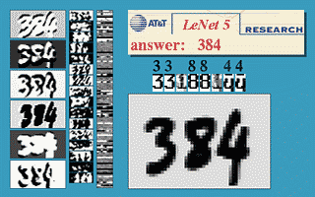
Example 1: Hand-written digits
Data representation:
Greyscale images
Task: Classification (0,1,2,3…..9)
Problem features:
Highly variable inputs from same class
imperfect human classification,
high cost associated with errors so “don’t know” may be useful.

Slide 27
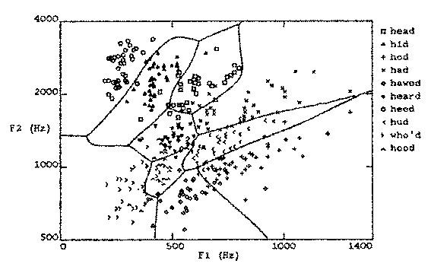
Example 2: Speech recognition
Data representation: features from spectral analysis of speech signals
Task:
Classification of vowel sounds in words of the form “h-?-d”
Problem features:
Highly variable data with same classification.
Good feature selection is very important.

Slide 28
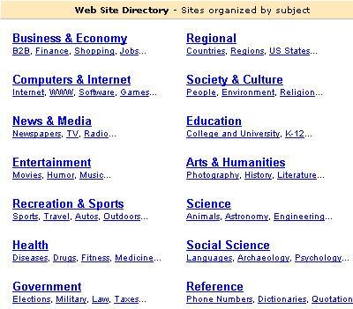
Example 3: Text classification
Task: classifying the given text to some category
Performance: percent of texts correctly classified
Examples: a database of some texts with given correct classifications

Slide 29
Text Classification Process
text files
word counts per file
Feature selection
data set
Learning Methods
Decision tree
Naïve Bayes
Bayes nets
Support vector
machine
test classifier

Slide 30
Text Representation
Vector space representation of documents
word1 word2 word3 word4 ...
  Doc 1 = <1, 0, 3, 0, … >
  Doc 2 = <0, 1, 0, 0, … >
  Doc 3 = <0, 0, 0, 5, … >
Mostly use: simple words, binary weights
Text can have 10⁷ or more dimensions
  e.g., 100k web pages had 2.5 million distinct words

Slide 31
Feature Selection
Word distribution - remove frequent and infrequent words based on Zipf’s law:
  frequency * rank ~ constant
# Words (f)
1 2 3 … m
Words by rank order (r)

Slide 32
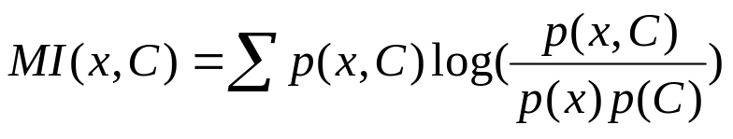
Feature Selection
Fit to categories - use mutual information to select features which best discriminate category vs. not
Designer features - domain specific, including non-text features
Use 100-500 best features from this process as input to learning methods

Slide 33
Training Examples for Concept EnjoySport
Concept: ”days on which my friend Aldo enjoys his favourite
water sports”
Task: predict the value of ”Enjoy Sport” for an arbitrary day
based on the values of the other attributes
attributes
Sky | Temp | Humid | Wind | Water | Fore-cast | Enjoy Sport
Sunny Sunny Rainy Sunny | Warm Warm Cold Warm | Normal High High High | Strong Strong Strong Strong | Warm Warm Warm Cool | Same Same Change Change | Yes Yes No Yes
instance

Slide 34
Representing Hypothesis
Hypothesis h is a conjunction of constraints on attributes
Each constraint can be:
  A specific value : e.g. Water=Warm
  A don’t care value : e.g. Water=?
  No value allowed (null hypothesis): e.g. Water=Ø
Example: hypothesis h
Sky Temp Humid Wind Water Forecast
< Sunny ? ? Strong ? Same >

Slide 35
Enjoy Concept Learning Task
Consider the target concept
  “days on which Aldo enjoys his favorite sport
Example | Sky | AirTemp | Humidity | Wind | Water | Forecast | EnjoySport
1 | Sunny | Warm | Normal | Strong | Warm | Same | Yes
2 | Sunny | Warm | High | Strong | Warm | Same | Yes
3 | Rainy | Cold | High | Strong | Warm | Change | No
4 | Sunny | Warm | High | Strong | Cool | Change | Yes
Positive and negative examples for the target concept EnjoySport

Slide 36
Enjoy Concept Learning Task
Give:
  Instances X: Possible days (described by attributes)
    Sky, AirTemp, Humidity, Wind, Water and Forecast
  Hypotheses H: Each hypothesis is described by a conjunction of constraints on attributes. The constraints may be “?”, “Ø “, or a specific value
  Target concept c: EnjoySport: X→{0,1} (1:Yes, 0:No)
  Training examples D: positive and negative, see Table2.1
Determine:
  A hypothesis h in H satisfying h(x)=c(x) for all x in X

Slide 37
General-to-Specific Ordering
More_general_then_or_equal_to:
  h_{j} and h_{k} are boolean-valued functions defined over X.
  h_{j} is more_general_then_or_equal_to h_{k}
  (Written as h_{j} ≥_{g}h_{k})
  iff (Vx∈X)[(h_{k}(x)=1→(h_{j}(x)=1)]
  Partial order over H
  h_{j} >_{g}h_{k}
Notes:
X satisfies h iff h(x)=1

Slide 38
Find-S Algorithm
Find a maximally specific hypothesis
Begin with the most specific possible hypothesis in H, then generalize when can’t “cover” a positive training example
For example:
  1. h←< Ø, Ø ,Ø ,Ø ,Ø ,Ø >
  2. h←< sunny, warm, normal, strong, warm, same>
  3. h←< sunny, warm, ?, strong, warm, same>
  4. Ignore the negative example
  5. h←< sunny, warm, ?, strong, ?, ?>

Slide 39
Find-S Algorithm
Two assumptions:
  The correct target concept is contained in H
  The training examples are correct
Some questions:
  Converge to the correct concept?
  Why prefer the most specific?
  Noise problem
  Several maximally specific consistent hypothesis?
Notes:
Output the most specific hypothesis within H that is consistent with the positive training examples
Detect error, accommodate such errors
No maximally specific consistent hypothesis (theoretical issue)

Slide 40
Inductive Bias

Slide 41
Inductive Bias
Fundamental assumption of inductive learning:
  The inductive learning hypothesis: Any hypothesis found to approximate the target function well over a sufficiently large set of training examples will also approximate the target function well over other unobserved examples.

Slide 42
Inductive Bias
Fundamental questions:
  What if the target concept is not contained in hypothesis space?
  The relationship between the size of hypothesis space, the ability of algorithm to generalize to unobserved instances, the number of training examples that must be observed

Slide 43
Inductive Bias
See the training examples:
It can’t be represented in H we defined
Example | Sky | AirTemp | Humidity | Wind | Water | Forecast | EnjoySport
1 | Sunny | Warm | Normal | Strong | Warm | Same | Yes
2 | Rainy | Warm | Normal | Strong | Warm | Same | No
3 | Cloudy | Warm | Normal | Strong | Warm | Same | Yes

Slide 44
Inductive Bias
Fundamental property of inductive inference
  A learner that makes no a priori assumptions regarding the identity of the target concept has no rational basis for classifying any unseen instances
Inductive bias
  The inductive bias of L is any minimal set of assertion B such that for any target concept c and corresponding training examples D_{c}
  (V x_{i} ∈X)[B∧D_{c} ∧ x_{i}├L(x_{i}, D_{c})]
Notes:
L(x_{i},D_{c}): Classification assigned to the instance x_{i} by L after training on the data D_{c}
(D_{c} ∧ x_{i} )> L(x_{i}, D_{c})

Slide 45
Inductive Bias
Inductive
Classification of new instance, or “don’t know”
Training examples
Candidate
Elimination
Algorithm
Using Hypothesis
Space H
New instance
Training examples
Classification of new instance, or “don’t know”
Theorem Prover
New instance
Assertion “H contains the target concept”
Inductive
bias
Deductive
Notes:
L(x_{i},D_{c}): Classification assigned to the instance x_{i} by L after training on the data D_{c}
(D_{c} ∧ x_{i} )> L(x_{i}, D_{c})

Slide 46
Inductive Learning Hypothesis
Any hypothesis found to approximate the target function well over the training examples, will also approximate the target function well over the unobserved examples.

Slide 47
Number of Instances, Concepts, Hypotheses
Sky: Sunny, Cloudy, Rainy
AirTemp: Warm, Cold
Humidity: Normal, High
Wind: Strong, Weak
Water: Warm, Cold
Forecast: Same, Change
#distinct instances : 3*2*2*2*2*2 = 96
#syntactically distinct hypotheses : 5*4*4*4*4*4=5120
#semantically distinct hypotheses : 1+4*3*3*3*3*3=973

Slide 48
Inductive Learning Methods
Find Similar
Decision Trees
Naïve Bayes
Bayes Nets
Support Vector Machines (SVMs)
All support:
  “Probabilities” - graded membership; comparability across categories
  Adaptive - over time; across individuals

Slide 49
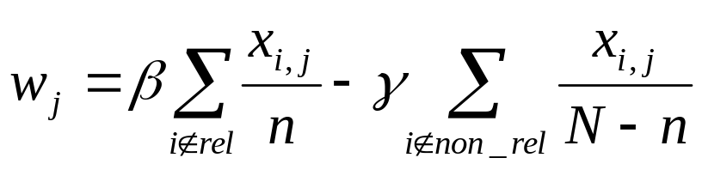
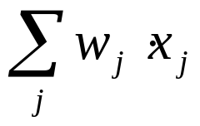

Find Similar
Aka, relevance feedback
Rocchio
Classifier parameters are a weighted combination of weights in positive and negative examples -- “centroid”
New items classified using:
Use all features, idf weights,

Slide 50
Decision Trees
Learn a sequence of tests on features, typically using top-down, greedy search
Binary (yes/no) or continuous decisions
f₁
!f₁
f₇
!f₇
P(class) = .9
P(class) = .6
P(class) = .2

Slide 51
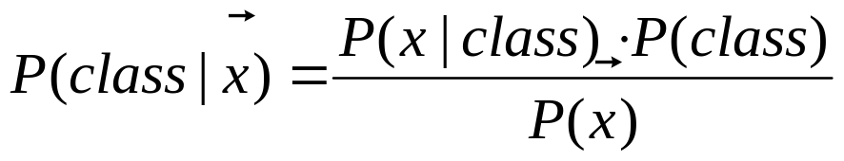
Naïve Bayes
Aka, binary independence model
Maximize: Pr (Class | Features)
Assume features are conditionally independent - math easy; surprisingly effective
C
x₁
x₂
x₃
x_{n}

Slide 52
Bayes Nets
Maximize: Pr (Class | Features)
Does not assume independence of features - dependency modeling
C
x₁
x₂
x₃
x_{n}

Slide 53
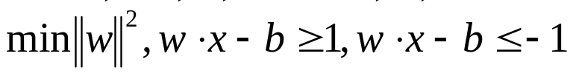


Support Vector Machines
Vapnik (1979)
Binary classifiers that maximize margin
  Find hyperplane separating positive and negative examples
  Optimization for maximum margin:
  Classify new items using:
support vectors

Slide 54
Support Vector Machines
Extendable to:
  Non-separable problems (Cortes & Vapnik, 1995)
  Non-linear classifiers (Boser et al., 1992)
Good generalization performance
  OCR (Boser et al.)
  Vision (Poggio et al.)
  Text classification (Joachims)

Slide 55
Machine Learning 3
Decision tree induction
Sudeshna Sarkar
IIT Kharagpur

Slide 56
Outline
Decision tree representation
ID3 learning algorithm
Entropy, information gain
Overfitting

Slide 57
Decision Tree for EnjoySport
Outlook
Sunny
Overcast
Rain
Humidity
Yes
Wind
High
Normal
Strong
Weak
No
Yes
No
Yes

Slide 58
Decision Tree for EnjoySport
Outlook
Sunny
Overcast
Rain
Humidity
Each internal node tests an attribute
High
Normal
Each branch corresponds to an
attribute value node
No
Yes
Each leaf node assigns a classification

Slide 59
Decision Tree for EnjoySport
Outlook Temperature Humidity Wind PlayTennis
Sunny Hot High Weak ?
No
Outlook
Sunny
Overcast
Rain
Humidity
Yes
Wind
High
Normal
Strong
Weak
No
Yes
No
Yes

Slide 60
Decision Tree for Conjunction
Outlook=Sunny ∧ Wind=Weak
Outlook
Sunny
Overcast
Rain
Wind
No
No
Strong
Weak
No
Yes

Slide 61
Decision Tree for Disjunction
Outlook=Sunny ∨ Wind=Weak
Outlook
Sunny
Overcast
Rain
Yes
Wind
Wind
Strong
Weak
Strong
Weak
No
Yes
No
Yes

Slide 62
Decision Tree for XOR
Outlook=Sunny XOR Wind=Weak
Outlook
Sunny
Overcast
Rain
Wind
Wind
Wind
Strong
Weak
Strong
Weak
Strong
Weak
Yes
No
No
Yes
No
Yes

Slide 63
Decision Tree
decision trees represent disjunctions of conjunctions
Outlook
Sunny
Overcast
Rain
Humidity
Yes
Wind
High
Normal
Strong
Weak
No
Yes
No
Yes
(Outlook=Sunny ∧ Humidity=Normal)
∨ (Outlook=Overcast)
∨ (Outlook=Rain ∧ Wind=Weak)

Slide 64
When to consider Decision Trees
Instances describable by attribute-value pairs
Target function is discrete valued
Disjunctive hypothesis may be required
Possibly noisy training data
Missing attribute values
Examples:
  Medical diagnosis
  Credit risk analysis
  Object classification for robot manipulator (Tan 1993)

Slide 65
Top-Down Induction of Decision Trees ID3
A ← the “best” decision attribute for next node
Assign A as decision attribute for node
3. For each value of A create new descendant
Sort training examples to leaf node according to
the attribute value of the branch
If all training examples are perfectly classified (same value of target attribute) stop, else iterate over new leaf nodes.

Slide 66
Which Attribute is ”best”?
[29+,35-]
A₁=?
A₂=?
[29+,35-]
True
False
True
False
[21+, 5-]
[8+, 30-]
[18+, 33-]
[11+, 2-]

Slide 67
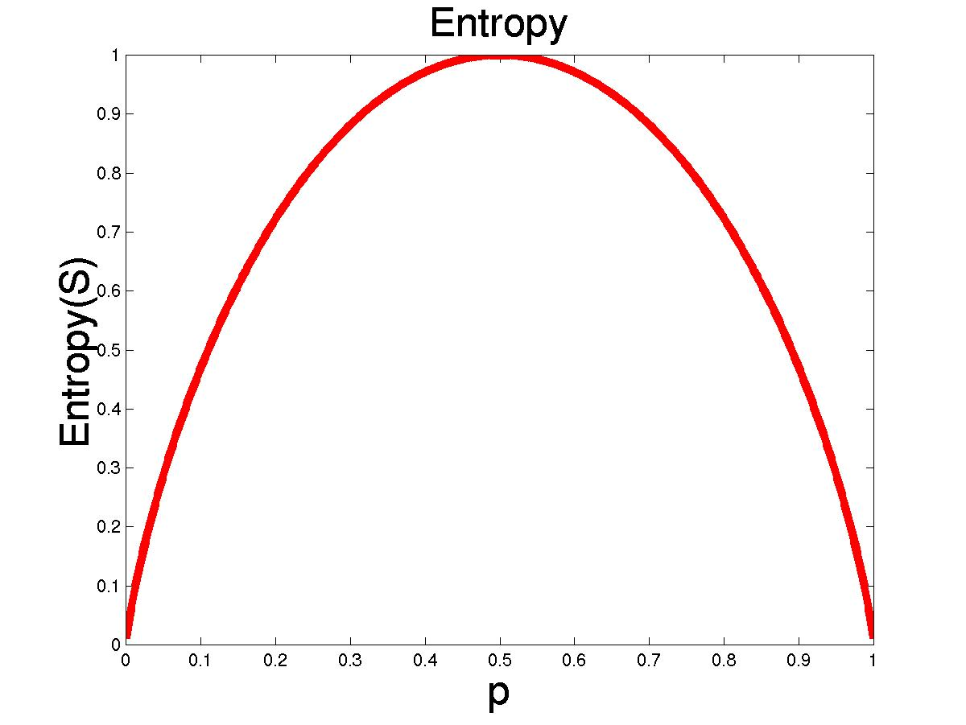
Entropy
S is a sample of training examples
p₊ is the proportion of positive examples
p₋ is the proportion of negative examples
Entropy measures the impurity of S
  Entropy(S) = -p₊ log₂ p₊ - p₋ log₂ p₋

Slide 68
Entropy
Entropy(S)= expected number of bits needed to encode class (+ or -) of randomly drawn members of S (under the optimal, shortest length-code)
Information theory optimal length code assign
–log₂ p bits to messages having probability p.
So the expected number of bits to encode
(+ or -) of random member of S:
  -p₊ log₂ p₊ - p₋ log₂ p₋
(log 0 = 0)

Slide 69
Information Gain
Gain(S,A): expected reduction in entropy due to sorting S on attribute A
Gain(S,A)=Entropy(S) - ∑_{v∈values(A)} |S_{v}|/|S| Entropy(S_{v})
Entropy([29+,35-]) = -29/64 log₂ 29/64 – 35/64 log₂ 35/64
= 0.99
[29+,35-]
A₁=?
A₂=?
[29+,35-]
True
False
True
False
[21+, 5-]
[8+, 30-]
[18+, 33-]
[11+, 2-]

Slide 70
Information Gain
Entropy([18+,33-]) = 0.94
Entropy([8+,30-]) = 0.62
Gain(S,A₂)=Entropy(S)
-51/64*Entropy([18+,33-])
-13/64*Entropy([11+,2-])
=0.12
Entropy([21+,5-]) = 0.71
Entropy([8+,30-]) = 0.74
Gain(S,A₁)=Entropy(S)
-26/64*Entropy([21+,5-])
-38/64*Entropy([8+,30-])
=0.27
[29+,35-]
A₁=?
A₂=?
[29+,35-]
True
False
True
False
[21+, 5-]
[8+, 30-]
[18+, 33-]
[11+, 2-]

Slide 71
Training Examples
Day | Outlook | Temp. | Humidity | Wind | EnjoySport
D1 | Sunny | Hot | High | Weak | No
D2 | Sunny | Hot | High | Strong | No
D3 | Overcast | Hot | High | Weak | Yes
D4 | Rain | Mild | High | Weak | Yes
D5 | Rain | Cool | Normal | Weak | Yes
D6 | Rain | Cool | Normal | Strong | No
D7 | Overcast | Cool | Normal | Weak | Yes
D8 | Sunny | Mild | High | Weak | No
D9 | Sunny | Cold | Normal | Weak | Yes
D10 | Rain | Mild | Normal | Strong | Yes
D11 | Sunny | Mild | Normal | Strong | Yes
D12 | Overcast | Mild | High | Strong | Yes
D13 | Overcast | Hot | Normal | Weak | Yes
D14 | Rain | Mild | High | Strong | No

Slide 72
Selecting the Next Attribute
S=[9+,5-]
E=0.940
S=[9+,5-]
E=0.940
Humidity
Wind
High
Normal
Weak
Strong
[3+, 4-]
[6+, 1-]
[6+, 2-]
[3+, 3-]
E=0.592
E=0.811
E=0.985
E=1.0
Gain(S,Humidity)
=0.940-(7/14)*0.985
– (7/14)*0.592
=0.151
Gain(S,Wind)
=0.940-(8/14)*0.811
– (6/14)*1.0
=0.048

Slide 73
Selecting the Next Attribute
S=[9+,5-]
E=0.940
Outlook
Temp ?
Over
cast
Sunny
Rain
[2+, 3-]
[4+, 0]
[3+, 2-]
E=0.971
E=0.0
E=0.971
Gain(S,Outlook)
=0.940-(5/14)*0.971
-(4/14)*0.0 – (5/14)*0.0971
=0.247

Slide 74
ID3 Algorithm
[D1,D2,…,D14]
[9+,5-]
Outlook
Sunny
Overcast
Rain
S_{sunny}=[D1,D2,D8,D9,D11]
[2+,3-]
[D3,D7,D12,D13]
[4+,0-]
[D4,D5,D6,D10,D14]
[3+,2-]
?
Yes
?
Gain(S_{sunny} , Humidity)=0.970-(3/5)0.0 – 2/5(0.0) = 0.970
Gain(S_{sunny} , Temp.)=0.970-(2/5)0.0 –2/5(1.0)-(1/5)0.0 = 0.570
Gain(S_{sunny} , Wind)=0.970= -(2/5)1.0 – 3/5(0.918) = 0.019

Slide 75
ID3 Algorithm
Outlook
Sunny
Overcast
Rain
Humidity
Yes
Wind
[D3,D7,D12,D13]
High
Normal
Strong
Weak
No
Yes
No
Yes
[D1,D2]
[D8,D9,D11]
[D6,D14]
[D4,D5,D10]

Slide 76
Hypothesis Space Search ID3
+ - +
A2
A1
+ - +
+ - -
+ - +
- - +
A2
A2
-
+ - +
-
A3
A4
+ -
- +

Slide 77
Hypothesis Space Search ID3
Hypothesis space is complete!
  Target function surely in there…
Outputs a single hypothesis
No backtracking on selected attributes (greedy search)
  Local minimal (suboptimal splits)
Statistically-based search choices
  Robust to noisy data
Inductive bias (search bias)
  Prefer shorter trees over longer ones
  Place high information gain attributes close to the root

Slide 78
Converting a Tree to Rules
Outlook
Sunny
Overcast
Rain
Humidity
Yes
Wind
High
Normal
Strong
Weak
No
Yes
No
Yes
R₁: If (Outlook=Sunny) ∧ (Humidity=High) Then PlayTennis=No
R₂: If (Outlook=Sunny) ∧ (Humidity=Normal) Then PlayTennis=Yes
R₃: If (Outlook=Overcast) Then PlayTennis=Yes
R₄: If (Outlook=Rain) ∧ (Wind=Strong) Then PlayTennis=No
R₅: If (Outlook=Rain) ∧ (Wind=Weak) Then PlayTennis=Yes

Slide 79
Continuous Valued Attributes
Create a discrete attribute to test continuous
Temperature = 24.5⁰C
(Temperature > 20.0⁰C) = {true, false}
Where to set the threshold?
Temperature | 15⁰C | 18⁰C | 19⁰C | 22⁰C | 24⁰C | 27⁰C
PlayTennis | No | No | Yes | Yes | Yes | No

Slide 80
Attributes with many Values
Problem: if an attribute has many values, maximizing InformationGain will select it.
E.g.: Imagine using Date=12.7.1996 as attribute
perfectly splits the data into subsets of size 1
Use GainRatio instead of information gain as criteria:
GainRatio(S,A) = Gain(S,A) / SplitInformation(S,A)
SplitInformation(S,A) = -Σ_{i=1..c} |S_{i}|/|S| log₂ |S_{i}|/|S|
Where S_{i} is the subset for which attribute A has the value v_{i}

Slide 81
Attributes with Cost
Consider:
Medical diagnosis : blood test costs 1000 SEK
Robotics: width_from_one_feet has cost 23 secs.
How to learn a consistent tree with low expected cost?
Replace Gain by :
Gain²(S,A)/Cost(A) [Tan, Schimmer 1990]
2^{Gain(S,A)}-1/(Cost(A)+1)^{w} w ∈[0,1] [Nunez 1988]

Slide 82
Unknown Attribute Values
What if examples are missing values of A?
Use training example anyway sort through tree
If node n tests A, assign most common value of A among other examples sorted to node n.
Assign most common value of A among other examples with same target value
Assign probability pi to each possible value vi of A
  Assign fraction pi of example to each descendant in tree
Classify new examples in the same fashion

Slide 83
Occam’s Razor: prefer shorter hypotheses
Why prefer short hypotheses?
Argument in favor:
  Fewer short hypotheses than long hypotheses
  A short hypothesis that fits the data is unlikely to be a coincidence
  A long hypothesis that fits the data might be a coincidence
Argument opposed:
  There are many ways to define small sets of hypotheses
  E.g. All trees with a prime number of nodes that use attributes beginning with ”Z”
  What is so special about small sets based on size of hypothesis

Slide 84
Overfitting
Consider error of hypothesis h over
Training data: error_{train}(h)
Entire distribution D of data: error_{D}(h)
Hypothesis h∈H overfits training data if there is an alternative hypothesis h’∈H such that
error_{train}(h) < error_{train}(h’)
and
error_{D}(h) > error_{D}(h’)

Slide 85
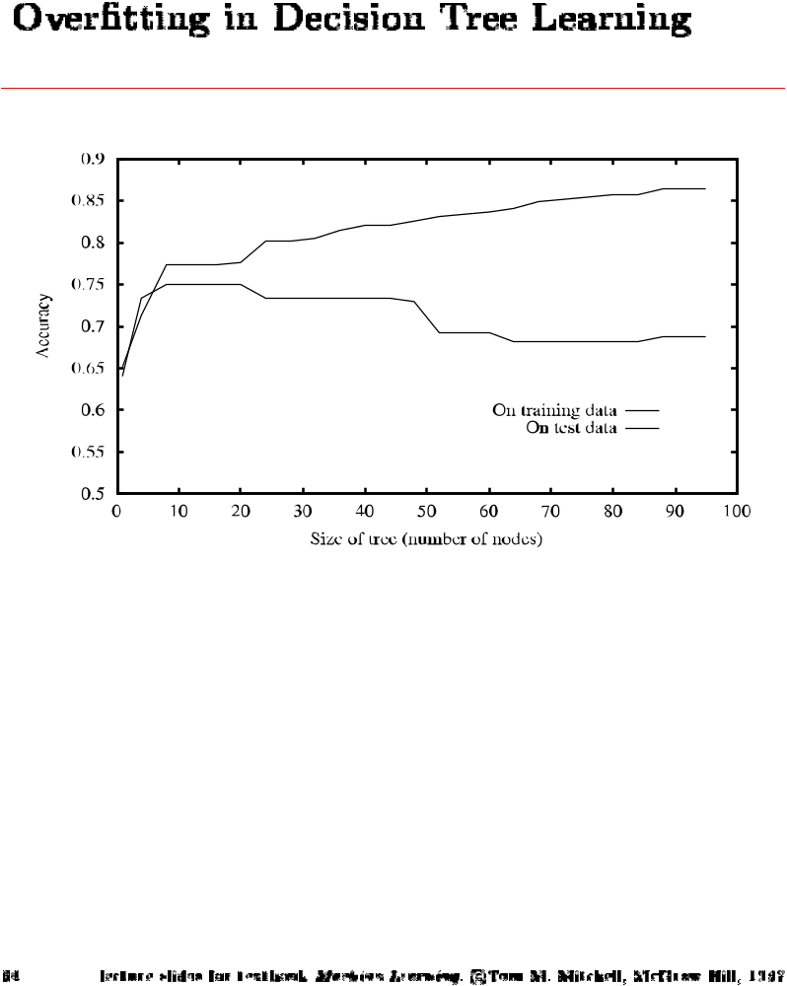
Overfitting in Decision Tree Learning

Slide 86
Avoid Overfitting
How can we avoid overfitting?
Stop growing when data split not statistically significant
Grow full tree then post-prune

Slide 87
Reduced-Error Pruning
Split data into training and validation set
Do until further pruning is harmful:
Evaluate impact on validation set of pruning each possible node (plus those below it)
Greedily remove the one that less improves the validation set accuracy
Produces smallest version of most accurate subtree

Slide 88
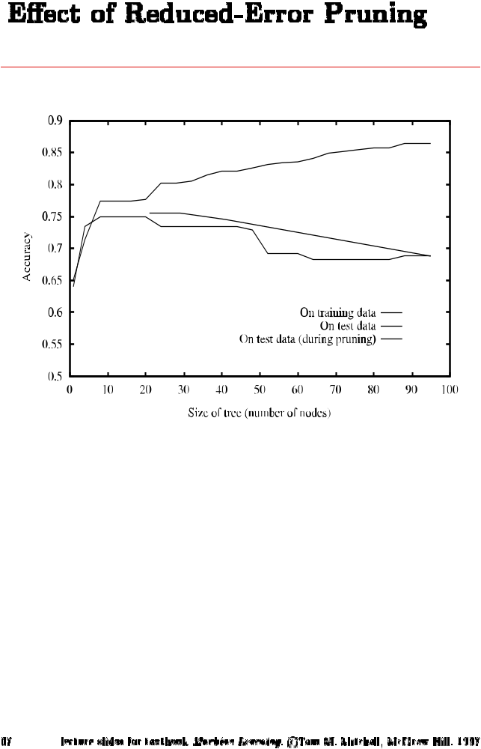
Effect of Reduced Error Pruning

Slide 89
Rule-Post Pruning
Convert tree to equivalent set of rules
Prune each rule independently of each other
Sort final rules into a desired sequence to use
Method used in C4.5

Slide 90
Cross-Validation
Estimate the accuracy of a hypothesis induced by a supervised learning algorithm
Predict the accuracy of a hypothesis over future unseen instances
Select the optimal hypothesis from a given set of alternative hypotheses
  Pruning decision trees
  Model selection
  Feature selection
Combining multiple classifiers (boosting)

Slide 91
Holdout Method
Partition data set D = {(v₁,y₁),…,(v_{n},y_{n})} into training D_{t} and validation set D_{h}=D\D_{t}
Training D_{t}
Validation D\D_{t}
acc_{h} = 1/h ∑ _{(vi,yi)∈Dh} δ(I(D_{t},v_{i}),y_{i})
I(D_{t},v_{i}) : output of hypothesis induced by learner I
trained on data D_{t} for instance v_{i}
δ(i,j) = 1 if i=j and 0 otherwise
Problems:
makes insufficient use of data
training and validation set are correlated

Slide 92
Cross-Validation
k-fold cross-validation splits the data set D into k mutually exclusive subsets D₁,D₂,…,D_{k}
Train and test the learning algorithm k times, each time it is trained on D\D_{i} and tested on D_{i}
D₁
D₂
D₃
D₄
D₁
D₂
D₃
D₄
D₁
D₂
D₃
D₄
D₁
D₂
D₃
D₄
D₁
D₂
D₃
D₄
acc_{cv} = 1/n ∑ _{(vi,yi)∈D} δ(I(D\D_{i},v_{i}),y_{i})

Slide 93
Cross-Validation
Uses all the data for training and testing
Complete k-fold cross-validation splits the dataset of size m in all (m over m/k) possible ways (choosing m/k instances out of m)
Leave n-out cross-validation sets n instances aside for testing and uses the remaining ones for training (leave one-out is equivalent to n-fold cross-validation)
  Leave one out is widely used
In stratified cross-validation, the folds are stratified so that they contain approximately the same proportion of labels as the original data set

Slide 94
Bootstrap
Samples n instances uniformly from the data set with replacement
Probability that any given instance is not chosen after n samples is (1-1/n)^{n} ≈ e⁻¹ ≈ 0.632
The bootstrap sample is used for training the remaining instances are used for testing
acc_{boot} = 1/b ∑ _{i=1}^{b} (0.632 ε0_{i} + 0.368 acc_{s})
where ε0_{i} is the accuracy on the test data of the i-th bootstrap sample, acc_{s} is the accuracy estimate on the training set and b the number of bootstrap samples

Slide 95
Wrapper Model
Input
features
Feature subset
search
Induction
algorithm
Feature subset
evaluation
Feature subset
evaluation

Slide 96
Wrapper Model
Evaluate the accuracy of the inducer for a given subset of features by means of n-fold cross-validation
The training data is split into n folds, and the induction algorithm is run n times. The accuracy results are averaged to produce the estimated accuracy.
Forward elimination:
  Starts with the empty set of features and greedily adds the feature that improves the estimated accuracy at most
Backward elimination:
  Starts with the set of all features and greedily removes features and greedily removes the worst feature

Slide 97
Bagging
For each trial t=1,2,…,T create a bootstrap sample of size N.
Generate a classifier C^{t} from the bootstrap sample
The final classifier C* takes class that receives the majority votes among the C^{t}
yes
instance
C*
yes
no
yes
…
C¹
C²
C^{T}
train
train
train
…
Training set₁
Training set₂
Training set_{T}

Slide 98
Bagging
Bagging requires ”instable” classifiers like for example decision trees or neural networks
”The vital element is the instability of the prediction method. If perturbing the learning set can cause significant changes in the predictor constructed, then bagging can improve accuracy.” (Breiman 1996)

